Slide 1
Chapter 16
Structures, Unions, and Enumerations

Slide 2
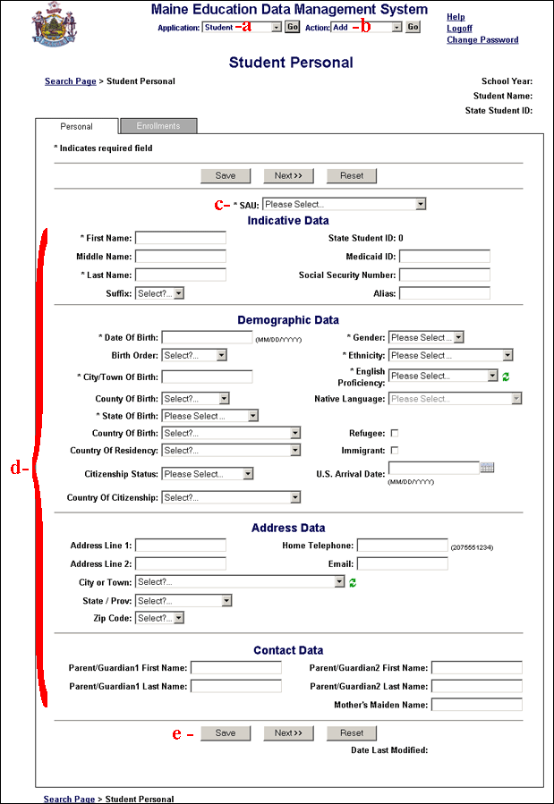
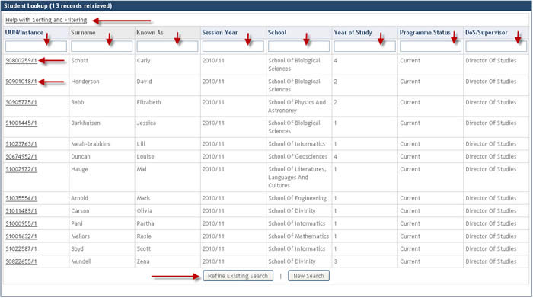

Slide 3
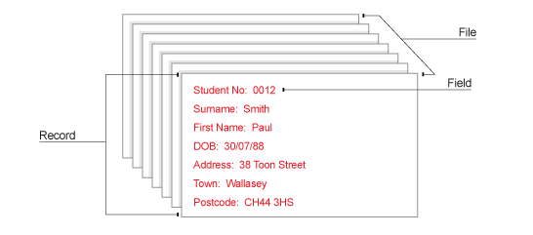

Slide 4
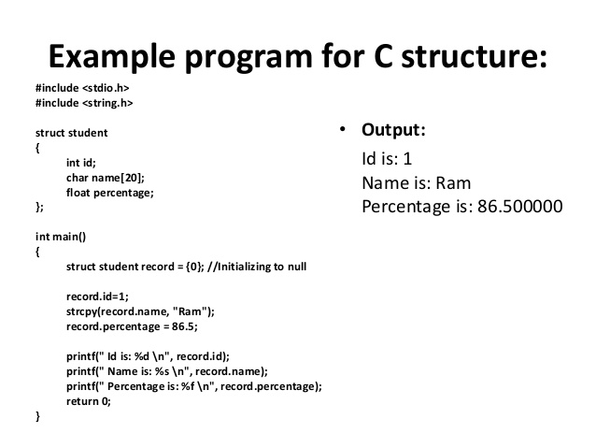

Slide 5
Structure Variables
The properties of a structure are different from those of an array.
The elements of a structure (its members) aren’t required to have the same type.
The members of a structure have names; to select a particular member, we specify its name, not its position.
In some languages, structures are called records, and members are known as fields.

Slide 6
Declaring Structure Variables
A structure is a logical choice for storing a collection of related data items.
A declaration of two structure variables that store information about parts in a warehouse:
struct {
int number;
char name[NAME_LEN+1];
int onHand;
} part1, part2;

Slide 7
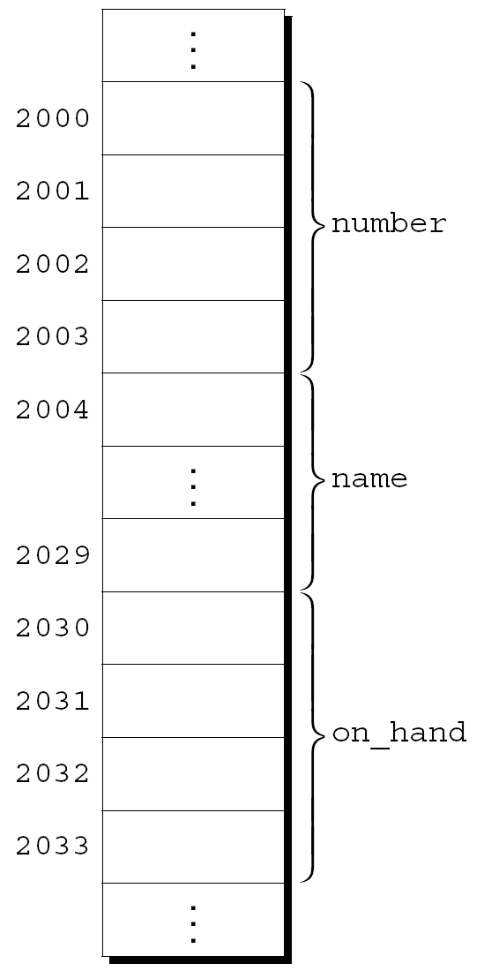
Declaring Structure Variables
The members of a structure are stored in memory in the order in which they’re declared.
Appearance of part1
Assumptions:
part1 is located at address 2000.
Integers occupy four bytes.
NAME_LEN has the value 25.
There are no gaps between the members.

Slide 8
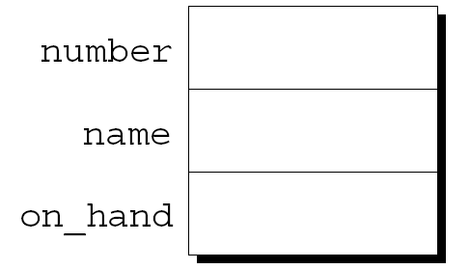
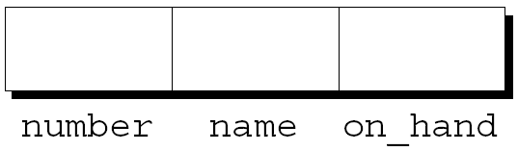
Declaring Structure Variables
Abstract representations of a structure:
Member values will go in the boxes later.

Slide 9
Declaring Structure Variables
Each structure represents a new scope
Any names declared in that scope won’t conflict with other names in a program.
In C terminology, each structure has a separate name space for its members.

Slide 10
Declaring Structure Variables
For example, the following declarations can appear in the same program:
struct {
int number;
char name[NAME_LEN+1];
int onHand;
} part1, part2;
struct {
char name[NAME_LEN+1];
int number;
char sex;
} employee1, employee2;

Slide 11
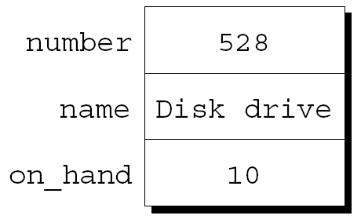
Initializing Structure Variables
A structure declaration may include an initializer:
struct {
int number;
char name[NAME_LEN+1];
int on_hand;
} part1 = {528, "Disk drive", 10},
part2 = {914, "Printer cable", 5};
Appearance of part1 after initialization:

Slide 12
Initializing Structure Variables
Structure initializers follow rules similar to those for array initializers.
Expressions used in a structure initializer must be constant. (This restriction is relaxed in C99.)
An initializer can have fewer members than the structure it’s initializing.
Any “leftover” members are given 0 as their initial value.

Slide 13
Designated Initializers (C99)
C99’s designated initializers can be used with structures.
The initializer for part1 shown in the previous example:
{528, "Disk drive", 10}
In a designated initializer, each value would be labeled by the name of the member that it initializes:
{.number = 528, .name = "Disk drive", .on_hand = 10}
The combination of the period and the member name is called a designator.

Slide 14
Designated Initializers (C99)
Designated initializers are easier to read and check for correctness.
Also, values in a designated initializer don’t have to be placed in the same order that the members are listed in the structure.
The programmer doesn’t have to remember the order in which the members were originally declared.
The order of the members can be changed in the future without affecting designated initializers.

Slide 15
Designated Initializers (C99)
Not all values listed in a designated initializer need be prefixed by a designator.
Example:
{.number = 528, "Disk drive", .on_hand = 10}
The compiler assumes that "Disk drive" initializes the member that follows number in the structure.
Any members that the initializer fails to account for are set to zero.

Slide 16
Example: initialize in for loop
Output
a=0 b=0.5
a=1 b=1.5
a=2 b=2.5
a=3 b=3.5
a=4 b=4.5
for(struct { int a; float b; } s = { 0,0.5 } ; s.a < 5 ; ++s.a, ++s.b)
{
cout <<"a="<< s.a << " b=" << s.b << endl;
}

Slide 17
Operations on Structures
To access a member within a structure, we write the name of the structure first, then a period, then the name of the member.
Statements that display the values of part1’s members:
printf("Part number: %d\n", part1.number);
printf("Part name: %s\n", part1.name);
printf("Quantity on hand: %d\n", part1.on_hand);

Slide 18
Operations on Structures
The members of a structure are lvalues.
They can appear on the left side of an assignment or as the operand in an increment or decrement expression:
part1.number = 258;
/* changes part1's part number */
part1.onHand++;
/* increments part1's quantity on hand */

Slide 19
Operations on Structures
The period used to access a structure member is actually a C operator.
It takes precedence over nearly all other operators.
Example:
scanf("%d", &part1.on_hand);
The . operator takes precedence over the & operator, so & computes the address of part1.on_hand.

Slide 20
Operations on Structures
The other major structure operation is assignment:
part2 = part1;
The effect of this statement is to copy part1.number into part2.number, part1.name into part2.name, and so on.
Inspire you something?

Slide 21
Operations on Structures
Arrays can’t be copied using the = operator, but an array embedded within a structure is copied when the enclosing structure is copied.
Some programmers exploit this property by creating “dummy” structures to enclose arrays that will be copied later:
struct { int a[10]; } a1, a2;
a1 = a2;
/* legal, since a1 and a2 are structures */
Assignment ONLY!!!

Slide 22
Operations on Structures
The = operator can be used only with structures of compatible types.
Two structures declared at the same time (as part1 and part2 were) are compatible.
Structures declared using the same “structure tag” or the same type name are also compatible.
Other than assignment, C provides no operations on entire structures.
In particular, the == and != operators can’t be used with structures.

Slide 23
Structure Types
Suppose that a program needs to declare several structure variables with identical members.
We need a name that represents a type of structure, not a particular structure variable.
Ways to name a structure:
Declare a “structure tag”
Use typedef to define a type name

Slide 24
Declaring a Structure Tag
A structure tag is a name used to identify a particular kind of structure.
The declaration of a structure tag named part:
struct part {
int number;
char name[NAME_LEN+1];
int onHand;
};
Note that a semicolon must follow the right brace.

Slide 25
Declaring a Structure Tag
The part tag can be used to declare variables:
struct part part1, part2;
We can’t drop the word struct:
part part1, part2; /*** WRONG ***/
part isn’t a type name; without the word struct, it is meaningless.
Since structure tags aren’t recognized unless preceded by the word struct, they don’t conflict with other names used in a program.

Slide 26
Declaring a Structure Tag
The declaration of a structure tag can be combined with the declaration of structure variables:
struct part {
int number;
char name[NAME_LEN+1];
int on_hand;
} part1, part2;

Slide 27
Declaring a Structure Tag
All structures declared to have type struct part are compatible with one another:
struct part part1 = {528, "Disk drive", 10};
struct part part2;
part2 = part1;
/* legal; both parts have the same type */

Slide 28
Defining a Structure Type
As an alternative to declaring a structure tag, we can use typedef to define a genuine type name.
A definition of a type named Part:
typedef struct {
int number;
char name[NAME_LEN+1];
int on_hand;
} Part;
Part can be used in the same way as the built-in types:
Part part1, part2;

Slide 29
Defining a Structure Type
When it comes time to name a structure, we can usually choose either to declare a structure tag or to use typedef.
However, declaring a structure tag is mandatory when the structure is to be used in a linked list (Chapter 17).

Slide 30
Structures as Arguments and Return Values
Functions may have structures as arguments
A function with a structure argument:
void printPart(struct part p)
{
printf("Part number: %d\n", p.number);
printf("Part name: %s\n", p.name);
printf("Quantity on hand: %d\n", p.onHand);
}
A call of printPart: printPart(part1);

Slide 31
Structures as Arguments and Return Values
A function that returns a part structure:
struct part buildPart(int number,
const char *name,
int onHand)
{
struct part p;
p.number = number;
strcpy(p.name, name);
p.onHand = onHand;
return p;
}
A call of buildPart:
part1 = buildPart(528, "Disk drive", 10);

Slide 32
Structures as Arguments and Return Values
Passing a structure to a function and returning a structure from a function both require making a copy of all members in the structure.
To avoid this overhead, it’s sometimes advisable to pass a pointer to a structure or return a pointer to a structure.
Chapter 17 gives examples of functions that have a pointer to a structure as an argument and/or return a pointer to a structure.

Slide 33
Structures as Arguments and Return Values
There are other reasons to avoid copying structures.
For example, the <stdio.h> header defines a type named FILE, which is typically a structure.
Each FILE structure stores information about the state of an open file and therefore must be unique in a program.
Every function in <stdio.h> that opens a file returns a pointer to a FILE structure.
Every function that performs an operation on an open file requires a FILE pointer as an argument.

Slide 34
Structures as Arguments and Return Values
Within a function, the initializer for a structure variable can be another structure:
void f(struct part part1)
{
struct part part2 = part1;
…
}
The structure being initialized must have automatic storage duration.

Slide 35
Compound Literals (C99)
Chapter 9 introduced the C99 feature known as the compound literal.
A compound literal can be used to create a structure “on the fly,” without first storing it in a variable.
The resulting structure can be passed as a parameter, returned by a function, or assigned to a variable.

Slide 36
Compound Literals (C99)
A compound literal can be used to create a structure that will be passed to a function:
printPart((struct part){528,"Disk drive", 10});
The compound literal is shown in bold.
A compound literal can also be assigned to a variable:
part1 = (struct part) {528, "Disk drive", 10};
A compound literal consists of a type name within parentheses, followed by a set of values in braces.
When a compound literal represents a structure, the type name can be a structure tag preceded by the word struct or a typedef name.

Slide 37
Compound Literals (C99)
A compound literal may contain designators, just like a designated initializer:
print_part((struct part) { .on_hand = 10, .name = "Disk drive", .number = 528});
A compound literal may fail to provide full initialization, in which case any uninitialized members default to zero.

Slide 38
Nested Arrays and Structures
Structures and arrays can be combined without restriction.
Arrays may have structures as their elements, and structures may contain arrays and structures as members.

Slide 39
Nested Structures
Nesting one structure inside another is often useful.
Suppose that personName is the following structure:
struct personName {
char first[FIRST_NAME_LEN+1];
char middleInitial;
char last[LAST_NAME_LEN+1];
};

Slide 40
Nested Structures
We can use personName as part of a larger structure:
struct student {
struct personName name;
int id, age;
char sex;
} student1, student2;
Accessing student1’s first name, middle initial, or last name requires two applications of the . operator:
strcpy(student1.name.first, "Fred");

Slide 41
Nested Structures
Having name be a structure makes it easier to treat names as units of data.
A function that displays a name could be passed one personName argument instead of three arguments:
displayName(student1.name);
Copying the information from a personName structure to the name member of a student structure would take one assignment instead of three:
struct personName newName;
…
student1.name = newName;

Slide 42
Arrays of Structures
One of the most common combinations of arrays and structures is an array whose elements are structures.
This kind of array can serve as a simple database.
An array of part structures capable of storing information about 100 parts:
struct part inventory[100];

Slide 43
Arrays of Structures
Accessing a part in the array is done by using subscripting:
printPart(inventory[i]);
Accessing a member within a part structure requires a combination of subscripting and member selection:
inventory[i].number = 883;
Accessing a single character in a part name requires subscripting, followed by selection, followed by subscripting:
inventory[i].name[0] = '\0';

Slide 44
Initializing an Array of Structures
Initializing an array of structures is done in much the same way as initializing a multidimensional array.
Each structure has its own brace-enclosed initializer; the array initializer wraps another set of braces around the structure initializers.

Slide 45
Initializing an Array of Structures
One reason for initializing an array of structures is that it contains information that won’t change during program execution.
Example: an array that contains country codes used when making international telephone calls.
The elements of the array will be structures that store the name of a country along with its code:
struct dialing_code {
char *country;
int code;
};

Slide 46
Initializing an Array of Structures
struct dialingCode {
char *country;
int code;
};
const struct dialingCode countryCodes[] =
{{"Argentina", 54}, {"Bangladesh", 880},
{"Brazil", 55}, {"Burma (Myanmar)", 95},
{"China", 86}, {"Colombia", 57},
{"Congo, Dem. Rep. of", 243}, {"Egypt", 20},
{"Ethiopia", 251}, {"France", 33},
{"Germany", 49}, {"India", 91},
{"Indonesia", 62}, {"Iran", 98},
{"Italy", 39}, {"Japan", 81},
{"Mexico", 52}, {"Nigeria", 234},
{"Pakistan", 92}, {"Philippines", 63},
{"Poland", 48}, {"Russia", 7},
{"South Africa", 27}, {"South Korea", 82},
{"Spain", 34}, {"Sudan", 249},
{"Thailand", 66}, {"Turkey", 90},
{"Ukraine", 380}, {"United Kingdom", 44},
{"United States", 1}, {"Vietnam", 84}};
The inner braces around each structure value are optional.

Slide 47
Initializing an Array of Structures
C99’s designated initializers allow an item to have more than one designator.
A declaration of the inventory array that uses a designated initializer to create a single part:
struct part inventory[100] =
{[0].number = 528, [0].on_hand = 10,
[0].name[0] = '\0'};
The first two items in the initializer use two designators; the last item uses three.

Slide 48
Program: Maintaining a Parts Database
The inventory.c program illustrates how nested arrays and structures are used in practice.
The program tracks parts stored in a warehouse.
Information about the parts is stored in an array of structures.
Contents of each structure:
Part number
Name
Quantity

Slide 49
Program: Maintaining a Parts Database
Operations supported by the program:
Add a new part number, part name, and initial quantity on hand
Given a part number, print the name of the part and the current quantity on hand
Given a part number, change the quantity on hand
Print a table showing all information in the database
Terminate program execution

Slide 50
Program: Maintaining a Parts Database
The codes i (insert), s (search), u (update), p (print), and q (quit) will be used to represent these operations.
A session with the program:
Enter operation code: i
Enter part number: 528
Enter part name: Disk drive
Enter quantity on hand: 10
Enter operation code: s
Enter part number: 528
Part name: Disk drive
Quantity on hand: 10

Slide 51
Program: Maintaining a Parts Database
Enter operation code: s
Enter part number: 914
Part not found.
Enter operation code: i
Enter part number: 914
Enter part name: Printer cable
Enter quantity on hand: 5
Enter operation code: u
Enter part number: 528
Enter change in quantity on hand: -2

Slide 52
Program: Maintaining a Parts Database
Enter operation code: s
Enter part number: 528
Part name: Disk drive
Quantity on hand: 8
Enter operation code: p
Part Number Part Name Quantity on Hand
528 Disk drive 8
914 Printer cable 5
Enter operation code: q

Slide 53
Program: Maintaining a Parts Database
The program will store information about each part in a structure.
The structures will be stored in an array named inventory.
A variable named numParts will keep track of the number of parts currently stored in the array.

Slide 54
Program: Maintaining a Parts Database
An outline of the program’s main loop:
for (;;) {
prompt user to enter operation code;
read code;
switch (code) {
case 'i': perform insert operation; break;
case 's': perform search operation; break;
case 'u': perform update operation; break;
case 'p': perform print operation; break;
case 'q': terminate program;
default: print error message;
}
}

Slide 55
Program: Maintaining a Parts Database
Separate functions will perform the insert, search, update, and print operations.
Since the functions will all need access to inventory and numParts, these variables will be external.
The program is split into three files:
inventory.c (the bulk of the program)
readLine.h (contains the prototype for the readLine function)
readLine.c (contains the definition of readLine)

Slide 56
/* Maintains a parts database (array version) */
#include <stdio.h>
#include "readline.h"
#define NAME_LEN 25
#define MAX_PARTS 100
struct part {
int number;
char name[NAME_LEN+1];
int onHand;
} inventory[MAX_PARTS];
int numParts = 0; /* no. of parts currently stored */
int findPart(int number);
void insert(void);
void search(void);
void update(void);
void print(void);
inventory.c

Slide 57
int main(void)
{
char code;
for (;;) {
printf("Enter operation code: ");
scanf(" %c", &code);
while (getchar() != '\n');/* skips to end of line */
switch (code) {
case 'i': insert();
break;
case 's': search();
break;
case 'u': update();
break;
case 'p': print();
break;
case 'q': return 0;
default: printf("Illegal code\n");
}
printf("\n");
}// endof for loop
}

Slide 58
/**********************************************************
* findPart: Looks up a part number in the inventory *
* array. Returns the array index if the part *
* number is found; otherwise, returns -1. *
**********************************************************/
int findPart(int number)
{
int i;
for (i = 0; i < numParts; i++)
if (inventory[i].number == number)
return i;
return -1;
}

Slide 59
void insert(void)
{
int partNumber;
if (numParts == MAX_PARTS) {
printf("Database is full; can't add more parts.\n");
return;
}
printf("Enter part number: ");
scanf("%d", &partNumber);
if (findPart(partNumber) >= 0) {
printf("Part already exists.\n");
return;
}
inventory[numParts].number = partNumber;
printf("Enter part name: ");
readLine(inventory[numParts].name, NAME_LEN);
printf("Enter quantity on hand: ");
scanf("%d", &inventory[numParts].onHand);
numParts++;
}

Slide 60
/**********************************************************
* search: Prompts the user to enter a part number, then *
* looks up the part in the database. If the part *
* exists, prints the name and quantity on hand; *
* if not, prints an error message. *
**********************************************************/
void search(void)
{
int i, number;
printf("Enter part number: ");
scanf("%d", &number);
i = findPart(number);
if (i >= 0)
{
printf("Part name: %s\n", inventory[i].name);
printf("Quantity on hand:%d\n", inventory[i].onHand);
} else
printf("Part not found.\n");
}

Slide 61
/**********************************************************
* update: Prompts the user to enter a part number. *
* Prints an error message if the part doesn't *
* exist; otherwise, prompts the user to enter *
* change in quantity on hand and updates the *
* database. *
**********************************************************/
void update(void)
{
int i, number, change;
printf("Enter part number: ");
scanf("%d", &number);
i = findPart(number);
if (i >= 0)
{
printf("Enter change in quantity on hand: ");
scanf("%d", &change);
inventory[i].onHand += change;
} else
printf("Part not found.\n");
}

Slide 62
/**********************************************************
* print: Prints a listing of all parts in the database, *
* showing the part number, part name, and *
* quantity on hand. Parts are printed in the *
* order in which they were entered into the *
* database. *
**********************************************************/
void print(void)
{
int i;
printf("Part Number Part Name "
"Quantity on Hand\n");
for (i = 0; i < numParts; i++)
printf("%7d %-25s%11d\n", inventory[i].number,
inventory[i].name, inventory[i].onHand);
}

Slide 63
Accessing The Structure Element
struct Card
{
char *face; // pointer to char type
char *suit; // pointer to char type
};
void main()
{
struct Card p; // declare the struct type variables
struct Card *SPtr;
p.face = "Ace";
p.suit = "Spades";
SPtr = &p;
printf("Accessing structure element:\n“);
printf ("\n\'SPtr->suit\' = “, SPtr->suit);
printf("\'SPtr->face\' = “, SPtr->face);
}

Slide 64
Program: Maintaining a Parts Database
The version of readLine in Chapter 13 won’t work properly in the current program.
Consider what happens when the user inserts a part:
Enter part number: 528
Enter part name: Disk drive
The user presses the Enter key after entering the part number, leaving an invisible new-line character that the program must read.
When scanf reads the part number, it consumes the 5, 2, and 8, but leaves the new-line character unread.

Slide 65
Program: Maintaining a Parts Database
If we try to read the part name using the original readLine function, it will encounter the new-line character immediately and stop reading.
This problem is common when numerical input is followed by character input.
One solution is to write a version of readLine that skips white-space characters before it begins storing characters.
This solves the new-line problem and also allows us to avoid storing blanks that precede the part name.

Slide 66
readLine.h
#ifndef READLINE_H
#define READLINE_H
/**********************************************************
* readLine: Skips leading white-space characters, then *
* reads the remainder of the input line and *
* stores it in str. Truncates the line if its *
* length exceeds n. Returns the number of *
* characters stored. *
**********************************************************/
int readLine(char str[], int n);
#endif

Slide 67
#include <ctype.h>
#include <stdio.h>
#include "readline.h"
int readLine(char str[], int n)
{
int ch, i = 0;
while (isspace(ch = getchar()));
while (ch != '\n' && ch != EOF)
{
if (i < n)
str[i++] = ch;
ch = getchar();
}
str[i] = '\0';
return i;
}
readLine.c

Slide 68
Structure Padding
Architecture of a computer processor can read
1 word (4 byte in 32-bit CPU)
8-byte in 64-bit CPU
from memory at a time.
So, data are always aligned as 4 bytes package which leads to insert empty addresses between other member’s address

Slide 69
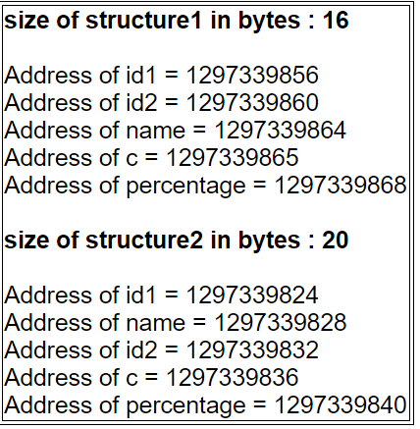
Structure Padding
#include <stdio.h>
#include <string.h>
// structure1 and 2 are the // same. They differ only in // member’s alignment
struct structure1
{
int id1;
int id2;
char name;
char c;
float percentage;
};
struct structure2
{
int id1;
char name;
int id2;
char c;
float percentage;
};
int main()
{
struct structure1 a;
struct structure2 b;
printf("size of structure1 in bytes : %d\n", sizeof(a));
printf ( "\n Address of id1 = %u", &a.id1 );
printf ( "\n Address of id2 = %u", &a.id2 );
printf ( "\n Address of name = %u", &a.name );
printf ( "\n Address of c = %u", &a.c );
printf ( "\n Address of percentage = %u", &a.percentage );
printf(" \n\nsize of structure2 in bytes : %d\n", sizeof(b));
printf ( "\n Address of id1 = %u", &b.id1 );
printf ( "\n Address of name = %u", &b.name );
printf ( "\n Address of id2 = %u", &b.id2 );
printf ( "\n Address of c = %u", &b.c );
printf ( "\n Address of percentage = %u", &b.percentage );
getchar();
return 0;
}

Slide 70
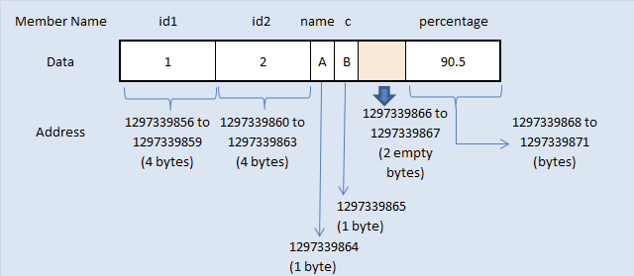
Structure Padding
struct structure1
{
int id1;
int id2;
char name;
char c;
float percentage;
};

Slide 71
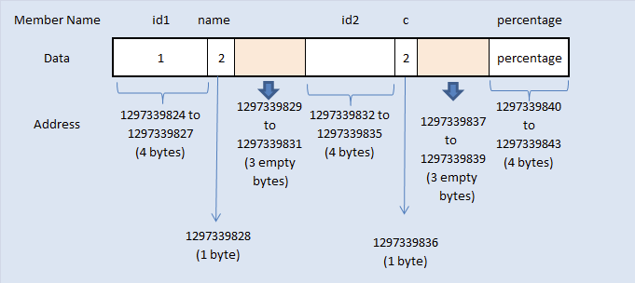
Structure Padding
struct structure2
{
int id1;
char name;
int id2;
char c;
float percentage;
};

Slide 72
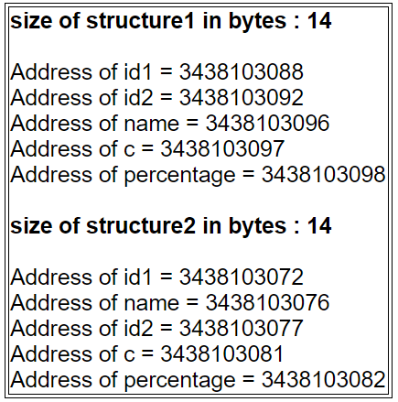
Structure Padding
How to avoid structure padding in C?
#pragma pack ( 1 )
Arranging memory for structure members very next to the end of other structure members.
VC++ supports this feature. But, some not!

Slide 73
Unions
A union, like a structure, consists of one or more members, possibly of different types.
The compiler allocates only enough space for the largest of the members, which overlay each other within this space.
Assigning a new value to one member alters the values of the other members as well.

Slide 74
Unions
An example of a union variable:
union {
int i;
double d;
} u;
The declaration of a union closely resembles a structure declaration:
struct {
int i;
double d;
} s;

Slide 75
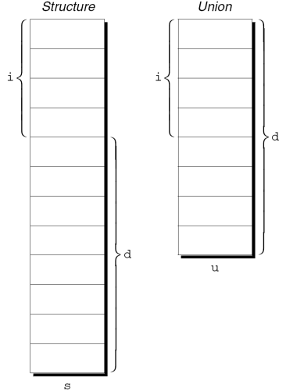
Unions
The structure s and the union u differ in just one way.
The members of s are stored at different addresses in memory.
The members of u are stored at the same address.

Slide 76
Unions
Members of a union are accessed in the same way as members of a structure:
u.i = 82;
u.d = 74.8;
Changing one member of a union alters any value previously stored in any of the other members.
Storing a value in u.d causes any value previously stored in u.i to be lost.
Changing u.i corrupts u.d.

Slide 77
Unions
The properties of unions are almost identical to the properties of structures.
We can declare union tags and union types in the same way we declare structure tags and types.
Like structures, unions can be copied using the = operator, passed to functions, and returned by functions.

Slide 78
Unions
Only the first member of a union can be given an initial value.
How to initialize the i member of u to 0:
union {
int i;
double d;
} u = {0};
The expression inside the braces must be constant. (The rules are slightly different in C99.)

Slide 79
Unions
Designated initializers can also be used with unions.
A designated initializer allows us to specify which member of a union should be initialized:
union {
int i;
double d;
} u = {.d = 10.0};
Only one member can be initialized, but it doesn’t have to be the first one.

Slide 80
Unions
Applications for unions:
Saving space
Building mixed data structures
Viewing storage in different ways (discussed in Chapter 20)

Slide 81
Using Unions to Save Space
Unions can be used to save space in structures.
Suppose that we’re designing a structure that will contain information about an item that’s sold through a gift catalog.
Each item has a stock number and a price, as well as other information that depends on the type of the item:
Books: Title, author, number of pages
Mugs: Design
Shirts: Design, colors available, sizes available

Slide 82
Using Unions to Save Space
A first attempt at designing the catalogItem structure:
struct catalogItem {
int stockNumber;
double price;
int itemType;
char title[TITLE_LEN+1];
char author[AUTHOR_LEN+1];
int numPages;
char design[DESIGN_LEN+1];
int colors;
int sizes;
};

Slide 83
Using Unions to Save Space
The itemType member would have one of the values BOOK, MUG, or SHIRT.
The colors and sizes members would store encoded combinations of colors and sizes.
This structure wastes space, since only part of the information in the structure is common to all items in the catalog.
By putting a union inside the catalogItem structure, we can reduce the space required by the structure.

Slide 84
Using Unions to Save Space
struct catalogItem {
int stockNumber;
double price;
int itemType;
union {
struct {
char title[TITLE_LEN+1];
char author[AUTHOR_LEN+1];
int numPages;
} book;
struct {
char design[DESIGN_LEN+1];
} mug;
struct {
char design[DESIGN_LEN+1];
int colors;
int sizes;
} shirt;
} item;
};

Slide 85
Using Unions to Save Space
If c is a catalogItem structure that represents a book, we can print the book’s title in the following way:
printf("%s", c.item.book.title);
As this example shows, accessing a union that’s nested inside a structure can be awkward.

Slide 86
Using Unions to Save Space
The catalogItem structure can be used to illustrate an interesting aspect of unions.
Normally, it’s not a good idea to store a value into one member of a union and then access the data through a different member.
However, there is a special case: two or more of the members of the union are structures, and the structures begin with one or more matching members.
If one of the structures is currently valid, then the matching members in the other structures will also be valid.

Slide 87
Using Unions to Save Space
The union embedded in the catalog_item structure contains three structures as members.
Two of these (mug and shirt) begin with a matching member (design).
Now, suppose that we assign a value to one of the design members:
strcpy(c.item.mug.design, "Cats");
The design member in the other structure will be defined and have the same value:
printf("%s", c.item.shirt.design);
/* prints "Cats" */

Slide 88
Using Unions to Build Mixed Data Structures
Unions can be used to create data structures that contain a mixture of data of different types.
Suppose that we need an array whose elements are a mixture of int and double values.
First, we define a union type whose members represent the different kinds of data to be stored in the array:
typedef union {
int i;
double d;
} Number;

Slide 89
Using Unions to Build Mixed Data Structures
Next, we create an array whose elements are Number values:
Number numberArray[1000];
A Number union can store either an int value or a double value.
This makes it possible to store a mixture of int and double values in numberArray:
numberArray[0].i = 5;
numberArray[1].d = 8.395;

Slide 90
Adding a “Tag Field” to a Union
There’s no easy way to tell which member of a union was last changed and therefore contains a meaningful value.
Consider the problem of writing a function that displays the value stored in a Number union:
void printNumber(Number n)
{
if (n contains an integer)
printf("%d", n.i);
else
printf("%g", n.d);
}
There’s no way for printNumber to determine whether n contains an integer or a floating-point number.

Slide 91
Adding a “Tag Field” to a Union
In order to keep track of this information, we can embed the union within a structure that has one other member: a “tag field” or “discriminant.”
The purpose of a tag field is to remind us what’s currently stored in the union.
itemType served this purpose in the catalogItem structure.

Slide 92
Adding a “Tag Field” to a Union
The Number type as a structure with an embedded union:
#define INT_KIND 0
#define DOUBLE_KIND 1
typedef struct {
int kind; /* tag field */
union {
int i;
double d;
} u;
} Number;
The value of kind will be either INT_KIND or DOUBLE_KIND.

Slide 93
Adding a “Tag Field” to a Union
Each time we assign a value to a member of u, we’ll also change kind to remind us which member of u we modified.
An example that assigns a value to the i member of u:
n.kind = INT_KIND;
n.u.i = 82;
n is assumed to be a Number variable.

Slide 94
Adding a “Tag Field” to a Union
When the number stored in a Number variable is retrieved, kind will tell us which member of the union was the last to be assigned a value.
A function that takes advantage of this capability:
void print_number(Number n)
{
if (n.kind == INT_KIND)
printf("%d", n.u.i);
else
printf("%g", n.u.d);
}

Slide 95
Enumerations
In many programs, we’ll need variables that have only a small set of meaningful values.
A variable that stores the suit of a playing card should have only four potential values: “clubs,” “diamonds,” “hearts,” and “spades.”

Slide 96
Enumerations
A “suit” variable can be declared as an integer, with a set of codes that represent the possible values of the variable:
int s; /* s will store a suit */
…
s = 2; /* 2 represents "hearts" */
Problems with this technique:
We can’t tell that s has only four possible values.
The significance of 2 isn’t apparent.

Slide 97
Enumerations
Using macros to define a suit “type” and names for the various suits is a step in the right direction:
#define SUIT int
#define CLUBS 0
#define DIAMONDS 1
#define HEARTS 2
#define SPADES 3
An updated version of the previous example:
SUIT s;
…
s = HEARTS;

Slide 98
Enumerations
Problems with this technique:
There’s no indication to someone reading the program that the macros represent values of the same “type.”
If the number of possible values is more than a few, defining a separate macro for each will be tedious.
The names CLUBS, DIAMONDS, HEARTS, and SPADES will be removed by the preprocessor, so they won’t be available during debugging.

Slide 99
Enumerations
C provides a special kind of type designed specifically for variables that have a small number of possible values.
An enumerated type is a type whose values are listed (“enumerated”) by the programmer.
Each value must have a name (an enumeration constant).

Slide 100
Enumerations
Although enumerations have little in common with structures and unions, they’re declared in a similar way:
enum {CLUBS, DIAMONDS, HEARTS, SPADES} s1, s2;
The names of enumeration constants must be different from other identifiers declared in the enclosing scope.

Slide 101
Enumerations
Enumeration constants are similar to constants created with the #define directive, but they’re not equivalent.
If an enumeration is declared inside a function, its constants won’t be visible outside the function.

Slide 102
Enumeration Tags and Type Names
As with structures and unions, there are two ways to name an enumeration: by declaring a tag or by using typedef to create a genuine type name.
Enumeration tags resemble structure and union tags:
enum suit {CLUBS, DIAMONDS, HEARTS, SPADES};
suit variables would be declared in the following way:
enum suit s1, s2;

Slide 103
Enumeration Tags and Type Names
As an alternative, we could use typedef to make Suit a type name:
typedef enum {CLUBS, DIAMONDS, HEARTS, SPADES} Suit;
Suit s1, s2;
In C89, using typedef to name an enumeration is an excellent way to create a Boolean type:
typedef enum {FALSE, TRUE} Bool;

Slide 104
Enumerations as Integers
Behind the scenes, C treats enumeration variables and constants as integers.
By default, the compiler assigns the integers 0, 1, 2, … to the constants in a particular enumeration.
In the suit enumeration, CLUBS, DIAMONDS, HEARTS, and SPADES represent 0, 1, 2, and 3, respectively.

Slide 105
Enumerations as Integers
The programmer can choose different values for enumeration constants:
enum suit {CLUBS = 1, DIAMONDS = 2,
HEARTS = 3, SPADES = 4};
The values of enumeration constants may be arbitrary integers, listed in no particular order:
enum dept {RESEARCH = 20,
PRODUCTION = 10, SALES = 25};
It’s even legal for two or more enumeration constants to have the same value.

Slide 106
Enumerations as Integers
When no value is specified for an enumeration constant, its value is one greater than the value of the previous constant.
The first enumeration constant has the value 0 by default.
Example:
enum EGA_colors {BLACK, LT_GRAY = 7,
DK_GRAY, WHITE = 15};
BLACK has the value 0, LT_GRAY is 7, DK_GRAY is 8, and WHITE is 15.

Slide 107
Enumerations as Integers
Enumeration values can be mixed with ordinary integers:
int i;
enum {CLUBS, DIAMONDS, HEARTS, SPADES} s;
i = DIAMONDS; /* i is now 1 */
s = 0; /* s is now 0 (CLUBS) */
s++; /* s is now 1 (DIAMONDS) */
i = s + 2; /* i is now 3 */
s is treated as a variable of some integer type.
CLUBS, DIAMONDS, HEARTS, and SPADES are names for the integers 0, 1, 2, and 3.

Slide 108
Enumerations as Integers
Although it’s convenient to be able to use an enumeration value as an integer, it’s dangerous to use an integer as an enumeration value.
For example, we might accidentally store the number 4—which doesn’t correspond to any suit—into s.

Slide 109
Using Enumerations to Declare “Tag Fields”
Enumerations are perfect for determining which member of a union was the last to be assigned a value.
In the Number structure, we can make the kind member an enumeration instead of an int:
typedef struct {
enum {INT_KIND, DOUBLE_KIND} kind;
union {
int i;
double d;
} u;
} Number;

Slide 110
Using Enumerations to Declare “Tag Fields”
The new structure is used in exactly the same way as the old one.
Advantages of the new structure:
Does away with the INT_KIND and DOUBLE_KIND macros
Makes it obvious that kind has only two possible values: INT_KIND and DOUBLE_KIND

Slide 111
#include <stdio.h>
enum week { sunday, monday, tuesday, wednesday, thursday, friday, saturday };
int main()
{
enum week today;
today = wednesday;
printf(“Day %d”,today+1); // Day 4
return 0;
}

Slide 112
#include <stdio.h>
enum designFlags {
BOLD = 1,
ITALICS = 2,
UNDERLINE = 4
};
int main()
{
int myDesign = BOLD | UNDERLINE;
printf("%d", myDesign);
return 0;
}
// 00000001
// | 00000100
// ___________
// 00000101

Slide 113
Summary of Structures

Slide 114
Structures
Declaring New Structure Types and struct variables
Use of typedef with structs
Scope of struct type definitions
Initializing variables of type struct
Accessing data fields within structs
Nested Structs
Structs and Arrays
Structs and Functions
Structs and Pointers
Struct bit fields
Enumerated Data Types
Unions

Slide 115
Declaring New Structure Types and struct variables
Tagged ( Named ) Structs
struct Part {
int number, on_hand;
char name [ NAME_LEN + 1 ];
double price;
};
struct Part p1, p2;

Slide 116
Declaring New Structure Types and struct variables
Tagged ( Named ) Structs
struct Student {
int nClasses;
char name [ NAME_LEN + 1 ];
double gpa;
} joe, sue, mary;
struct Student mike, carla;

Slide 117
Declaring New Structure Types and struct variables
Tagged ( Named ) Structs
create struct variables without creating a named struct type in the process
it is not possible to create additional variables of the same type, nor can they be passed to functions, etc.
Even if other struct variables are created with the same data types and field names in the same order, they are not considered the same type:
struct {
int nClasses;
char name [ NAME_LEN + 1 ];
double gpa;
} alice, bill; // alice and bill: same type, but not the same as struct Student
struct {
int nClasses;
char name [ NAME_LEN + 1 ];
double gpa;
} charlie, daniel; // charlie and daniel are the same type as each other, but not anyone else.

Slide 118
Use of typedef with structs
typedef struct Student {
int nClasses;
char name [ NAME_LEN + 1 ];
double gpa;
} Student;
Student phil, georgina;
typedef struct {
int nClasses;
char name [ NAME_LEN + 1 ];
double gpa;
} Student;
推薦

Slide 119
Initializing variables of type struct
typedef struct {
int nClasses;
char name [ NAME_LEN + 1 ];
double gpa;
} Student;
Student john = { 3, "John Doe", 4.0 }, susie = { 5, "Susie Jones" }; // Susie has a gpa of 0.0
Student jane = { .gpa = 4.0 }, sue = { .name = "Sue Smith", 3.5 }; // Sue has 0 classes and a gpa of 3.5

Slide 120
Accessing data fields within structs
john.nClasses = 4;
totalGPA += sue.gpa;

Slide 121
Assigning one struct to another
struct Student {
int nClasses;
char name [ 11];
double gpa;
} joe, sue, mary;
struct {
int nClasses;
char name [ 11];
double gpa;
} alice, bill;
struct {
int nClasses;
char name [11];
double gpa;
} charlie, daniel;
struct Student mike, carla;
If two variables are of the same struct type, then they can be directly assigned one to the other.
a potential problem if the structs contain pointers.
joe = sue; // Legal, both of the same type
mary = carla; // Also legal, both of the same type
alice = bill; // Still legal. Both the same unnamed type
alice = charlie; // Illegal. Different types, even though identical

Slide 122
Nested Structs
struct Exam CS107Exam2 =
{ 1000, 50, { 5, 4, 2013 },
{ 6, 0, false }
}; // All scores zero
CS107Exam2.nStudents = 90;
CS107Exam2.date.month = APRIL; CS107Exam2.time.hour = 6;
CS107Exam2.scores[ i ].part2 = 20;
struct Date {
int day, month, year;
};
struct Exam {
int room, nStudents;
struct Date date;
struct {
int hour, minute;
bool AM;
} time;
typedef struct Score{
int part1, part2, total;
} Score;
Score scores[ 100 ];
};

Slide 123
Structs and Arrays
Structs can contain arrays
Arrays can contain structs
Structs and Arrays can be nested in arbitrary levels of complexity.

Slide 124
Structs and Functions
Structs may be passed to and from functions just like any basic data types.
Individual structs are always passed by value, even if they contain arrays.
Arrays of structs are passed by pointer / address, just like any other array, even if they only contain a single value.
Some programmers use this trick to pass struct variables by pointer/address.

Slide 125
Structs and Pointers
struct Student alice, bob, *sptr = &alice, carol;
sptr->gpa = 4.0; // Same as (*sptr).gpa = 4.0;
void printStudent( const struct Student *imaStudent );
Pointers point to specific fields of structures
the type of the pointer must match the type of the field being pointed to:
double *gpaPtr = &carol.gpa; // same as &(carol.gpa)
*gpaPtr = 4.0;

Slide 126
Structures can also contain pointers, either to basic types or to structs of the same or different types.
struct Employee {
char *name;
struct Date * hiringDate;
};
This can cause potential problems if a struct containing a pointer is copied using the assignment operator, or passed by value to a function.
The problem is that a simple assignment of one struct to another of the same type will copy the pointer, but not the data pointed to by the pointer, which means that both structs will now contain pointers to the same location. This is termed a "shallow copy". Any changes made via one pointer will be seen by the other pointer.
The solution is to write a function that will perform a "deep copy", by first copying the data pointed to by the pointer, and then creating a new pointer that points to the newly copied data.

Slide 127
Struct bit fields
struct Packed_data {
unsigned int isElement:1; /* = 1 if element *
unsigned int atomicNumber:8; /* Maximum 128 */
unsigned int isReactant:1;
unsigned int isProduct:1;
unsigned int isCatalyst:1;
unsigned int StockIndex:16; /* Maximum 65,535 */
} chemicalInventory[ 10000 ];
Each data item in the above array takes up one 32-bit word ( with four bits wasted ), for a total of 4*10,000 bytes of storage for the entire array
As opposed to 24*10,000 words of storage if bitfields were not used

Slide 128
Enumerated Data Types
Enumerated types, variables, and typedefs, operate similarly to structs:
enum suits { CLUBS, HEARTS, SPADES, DIAMONDS, NOTRUMP } trump;
enum suits ew_bid, ns_bid;
typedef enum Direction { NORTH, SOUTH, EAST, WEST } Direction;
Direction nextMove = NORTH;
Values may be assigned to specific enum value names.
enum Errors { NONE=0, // Redundant. The first one would be zero anyway MINOR1=100, MINOR2, MINOR3, // 100, 101, and 102 MAJOR1=1000, MAJOR2, DIVIDE_BY_ZERO=1000 }; // 1000, 1001, and 1000 again.

Slide 129
Unions
Unions are declared, created, and used exactly the same as struts EXCEPT for one key difference:
Structs allocate enough space to store all of the fields in the struct. The first one is stored at the beginning of the struct, the second is stored after that, and so on.
Unions only allocate enough space to store the largest field listed, and all fields are stored at the same space

Slide 130
Unions
typedef struct Flight {
enum { PASSENGER, CARGO } type;
union {
int npassengers;
double tonnages; // Units are not necessarily tons.
} cargo;
} Flight;
Flight flights[ 1000 ];
flights[ 42 ].type = PASSENGER;
flights[ 42 ].cargo.npassengers = 150;
flights[ 20 ].type = CARGO;
flights[ 20 ].cargo.tonnages = 356.78;

Slide 131
Unions
Unions are sometimes also used to break up larger data items into smaller pieces
To extract four 8-bit bytes from a 32-bit int:
int nRead;
union {
unsigned int n;
unsigned char c[ 4 ];
} data;
…
data.n = nRead;
for( int i = 0; i < 4; i++ )
printf( "Byte %d of %ud is %ud\n", i, nRead, data.c[i]);

